Slide 1
IST 687 Final Project
Jeffrey Kao, Kendra Osburn, Benjamin Schneider, Scott Snow

Slide 2

NBA Player Data Set
NBA player data for every player from 1978 to mid 2016.
Original data set was over 17,000 rows and 83 columns.
Filter and cleaned the data to only analyze 2005-2015 data and 43 relevant columns.
Added other relevant data like MVP, Championship, and Runner Up.
For one of our questions, 11 rows with an “Average Player” was added for each year
Each “Average Player” had the mean of each statistic for that year

Slide 3
Business Questions
Which player statistics seem to have the most impact on the selection that was made for regular season mvp
Which team averages seem to have the most impact on the team that wins the Championship?
Do any random or non-random samples from this data set suggest something contrary?
Is there a sample of years where the statistics indicate, for either category, that the wrong player was chosen as MVP or there was an upset based on this data in the outcome of that year’s finals?
What similarities exist between the players or teams in those samples?
Can we draw any conclusions to what statistics about a player or team, might secure them an MVP award or NBA Championship over a more generally higher qualified player or team.
Did each player earn their salary.
How much of an impact did Salary expenditures have on season outcome.

Slide 4
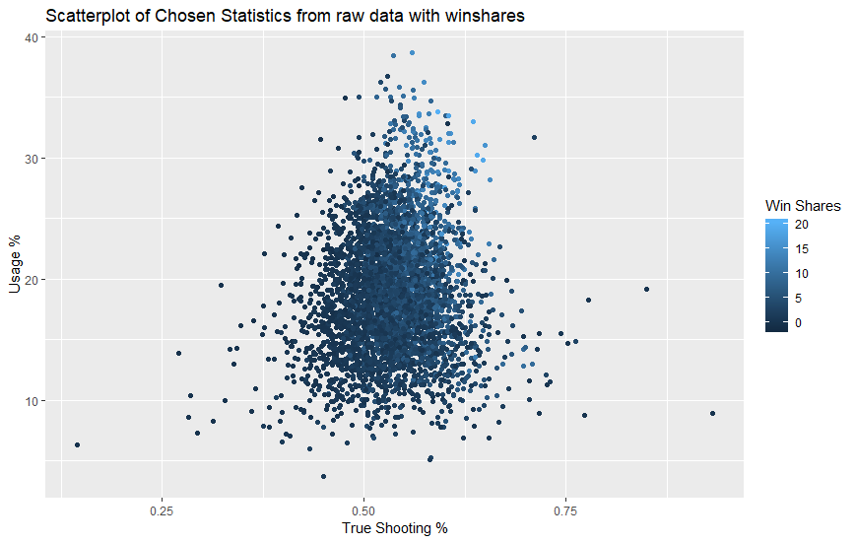
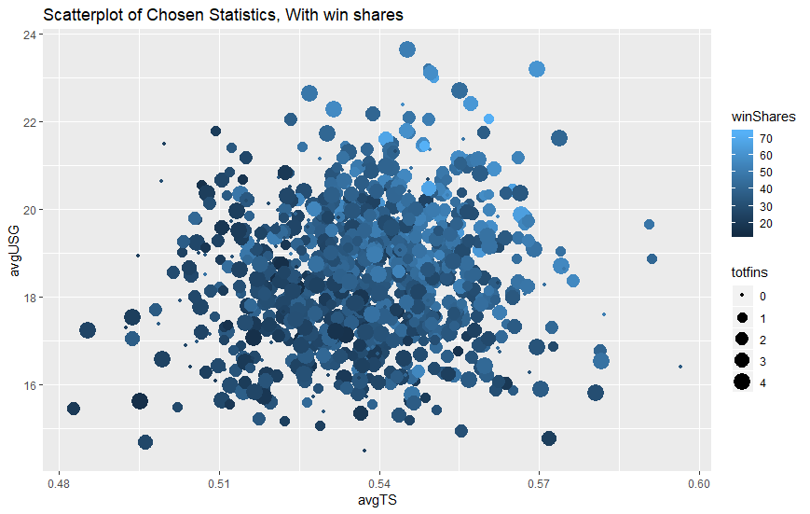
Sampling Visualizations
The following chart for three of the main variables(TS%, Win Shares and USG%) show that random sampling and simply looking at the raw data produce similar results.

Slide 5

MVP Salary Worth
Presented here are the MVP recipients mapped against their salaries.
Chart Arrangement
Light blue labeled players won the NBA title the year of their MVP accolade
Analysis
Lebron James was the highest paid MVP. Through the years of being the top paid, he was 1 for 3 in championship titles
MVPs are considered to be the players most likely to have a “max contract”. However, only 3 out of 11 teams won a championship

